Slide 1

Volume Growth Forecast
André Oliveira

Slide 2
Scope
Forecast volume of transfers in GBP.
12 month forecast.
Monthly aggregate level.
Split by transfer type (Personal and Business).

Slide 3
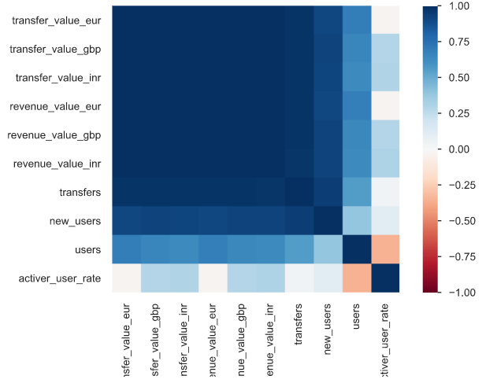
Exploratory Data Analysis
Main drivers of volume growth
Revenue: the volume of revenue is highly correlated with the volume of transfers. This is logical from a business perspective, as more transfers mean more fees generated (from those transfers).
Transfers: the number of transfers is highly correlated with the volume of transfers. This is valid from a business perspective, as more transfers mean more money sent.
Users: the user volume (new users in particular) is highly correlated with the volume of transfers. This is legitimate from a business perspective, as more users mean more transfers.
Correlation Matrix

Slide 4
Methodology
Approach
Multi-step multivariate time series forecast process with multiple time series (for each transfer type).
Vector Autoregression (VAR) is a multivariate forecasting algorithm that is used when multiple time series (variables) influence each other. It is considered as an autoregressive model because, each variable is modeled as a function of the past values, that is the predictors are nothing but the lags (time delayed value) of the series.
Variables
Transfer Volume in GBP.
Revenue Volume in GBP.
New users.
Number of transfers.
Evaluation Metrics
Bias.
Mean absolute percentage error (MAPE).
Mean absolute error (MAE).
Mean squared error (MSE).

Slide 5
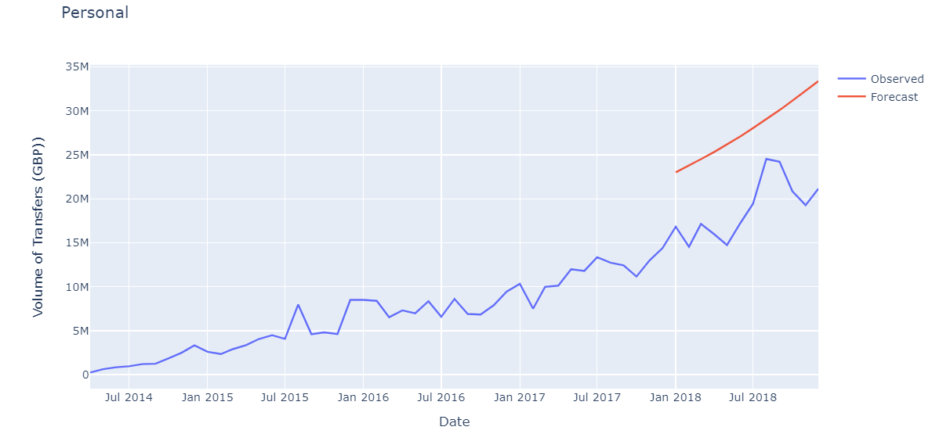
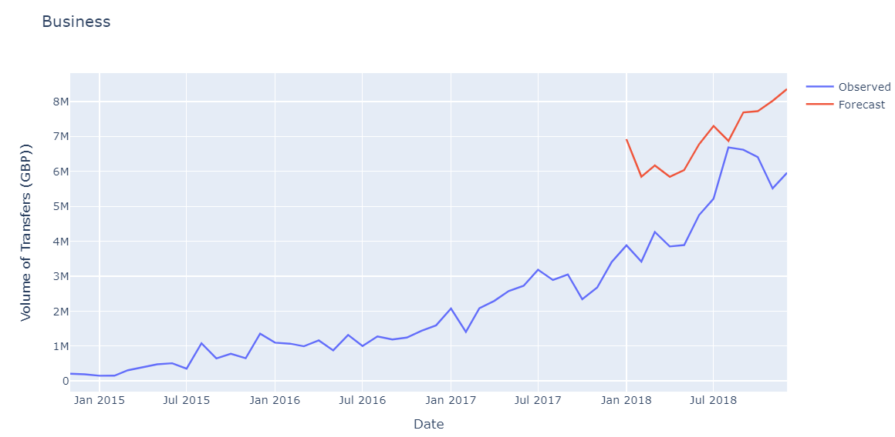
Results
The results from both models are not satisfactory, as the errors are very high and the bias is very low (negative), which means the models are both overforecasting by a huge margin.
 | Personal | Business
Bias | -7967792 | -1724257
MAPE | 49% | 42%
MAE | 8985564.6 | 1924127
MSE | 87018494474024 | 4225260420447

Slide 6
Challenges & Improvements
In order to have a reasonable results (e.g. MAPE less than 5%), both models can be improved to make sure that every time series’ mean, variance and covariance do not vary with time by:
Differencing: taking the difference with a particular time lag to make the time series stationary.
Decomposition: removing trend/seasonality by subtracting the trend/seasonality component from the time series decomposition results.
Log transformation: take the log of the series as an input.
Smoothening: reducing the effect of noise in a signal to get a fair approximation of the noise-filtered series. The smoothed version of the time series (e.g. moving average ) can be used as a feature to explain the original series itself.

